Slide 1

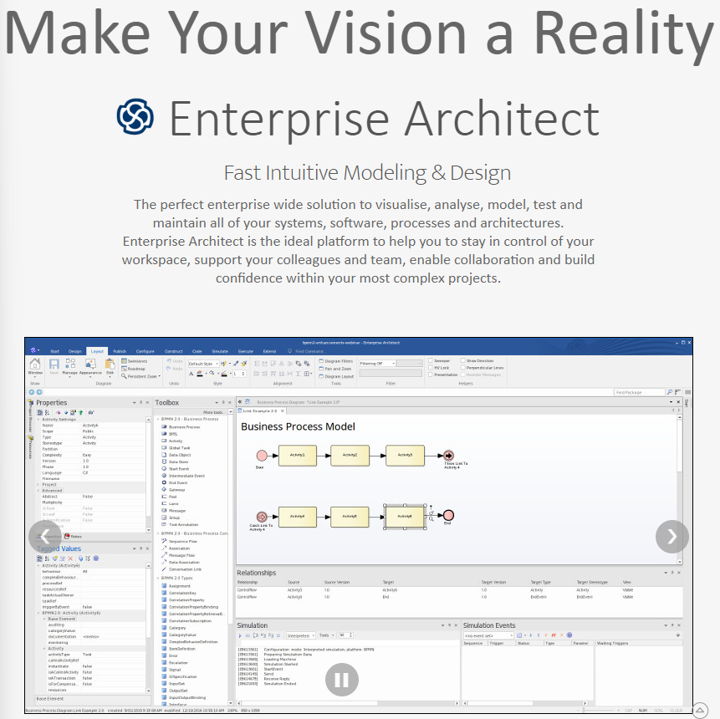
Learning Sparx® Enterprise Architect Tool
001 – Opening and Structure Introduction
Xiaoqi Zhao
https://github.com/yasenstar/enterprise_architecture

Slide 2
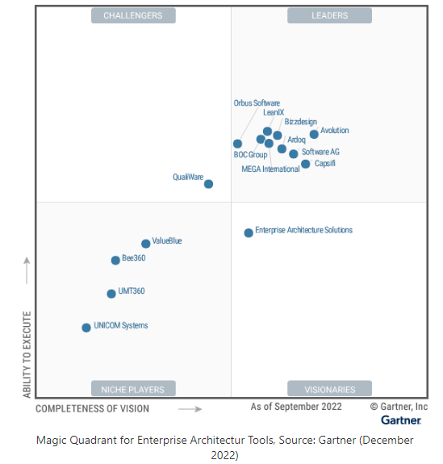
Magic Quadrant for Enterprise Architecture Tools - 2022
Archi – ArchiMate Modeling Tool
Sparx Systems Enterprise Architect

Slide 3
About Sparx Systems
https://sparxsystems.com/about.html
Sparx Systems specializes in high performance and scalable visual modeling tools for the planning, design and construction of software intensive systems.
… Sparx Systems is a leading vendor of innovative solutions based on the Unified Modeling Language (UML) and its related specifications
A Contributing Member of the Object Management Group (OMG), Sparx Systems is committed to realizing the potential of model-driven development based on open standards.
Our software is intended for use by analysts, designers, architects, developers, testers, project managers and maintenance staff - almost everyone involved in a software development project and in business analysis

Slide 4
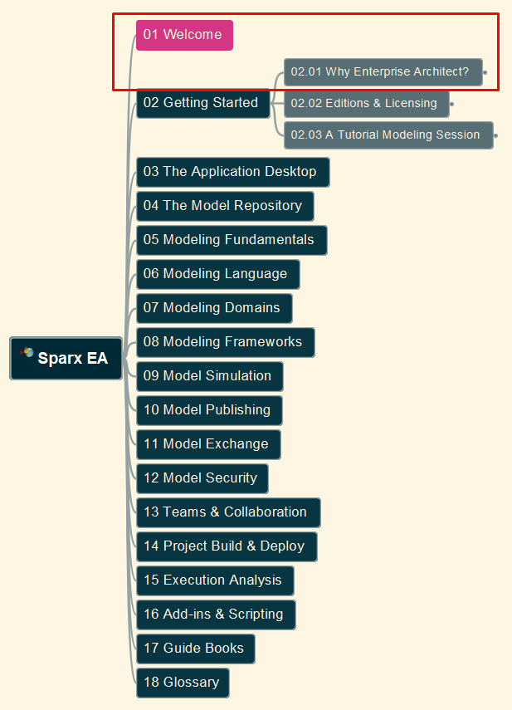
Learning Sparx® Enterprise Architect Tool
002 – Welcome and Why EA, Tool Exploration
Xiaoqi Zhao
https://github.com/yasenstar/enterprise_architecture

Slide 5
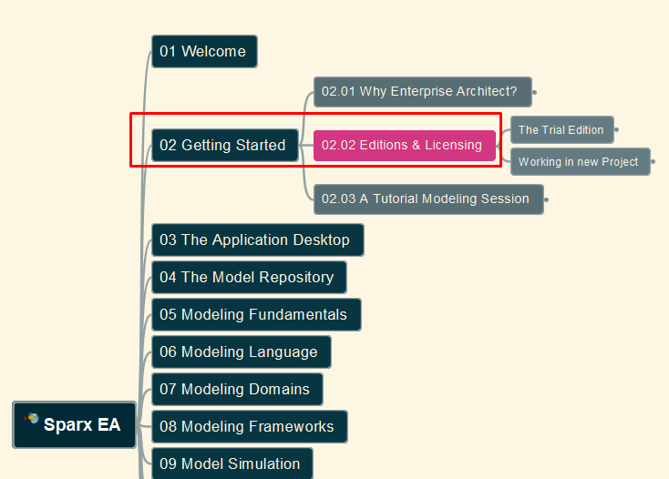
Learning Sparx® Enterprise Architect Tool
003 – Editions/Licensing, Installation
Xiaoqi Zhao
https://github.com/yasenstar/enterprise_architecture

Slide 6
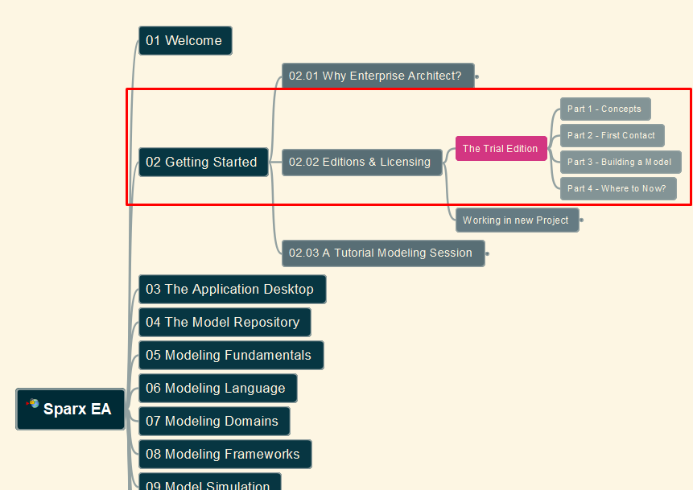
Learning Sparx® Enterprise Architect Tool
004 – Use Trial Edition for First Try
Xiaoqi Zhao
https://github.com/yasenstar/enterprise_architecture

Slide 7
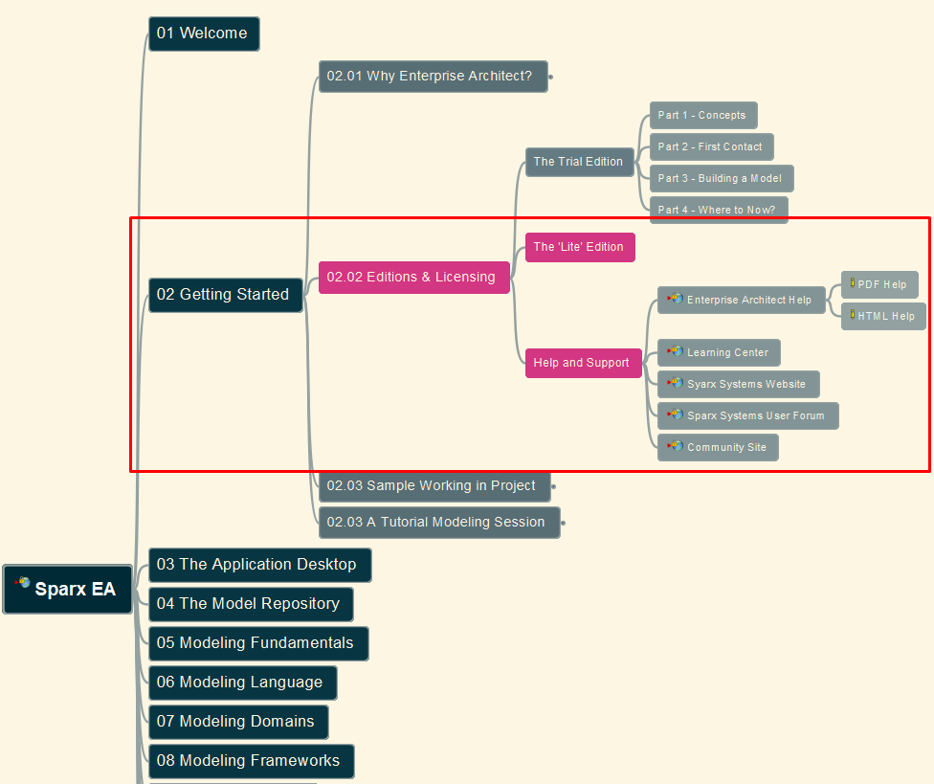
Learning Sparx® Enterprise Architect Tool
005 – “Lite Edition”, Help and Support
Xiaoqi Zhao
https://github.com/yasenstar/enterprise_architecture

Slide 8
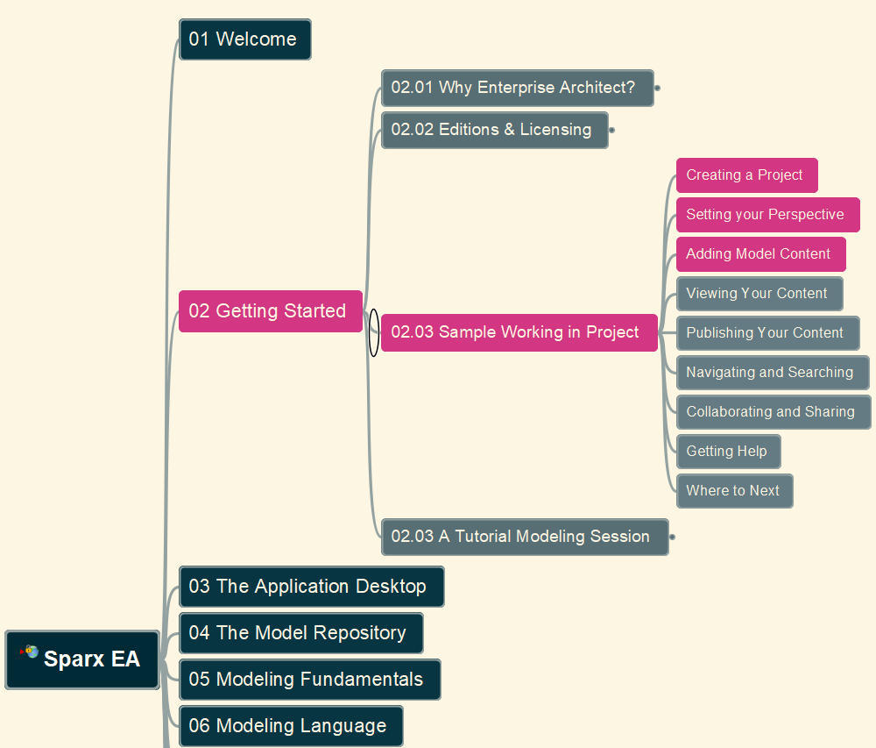
Learning Sparx® Enterprise Architect Tool
006 – Create a Project, Setting Perspective, Adding Model Content
Xiaoqi Zhao
https://github.com/yasenstar/enterprise_architecture

Slide 9
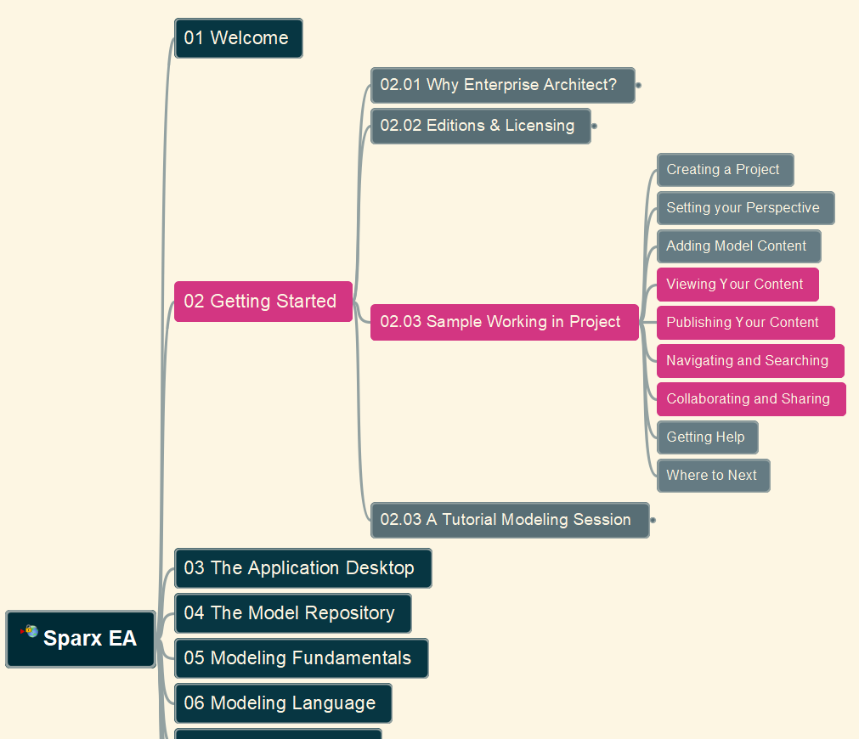
Learning Sparx® Enterprise Architect Tool
007 – Viewing / Publishing Content, Navigating and Searching, Collaborating and Sharing
Xiaoqi Zhao
https://github.com/yasenstar/enterprise_architecture

Slide 10
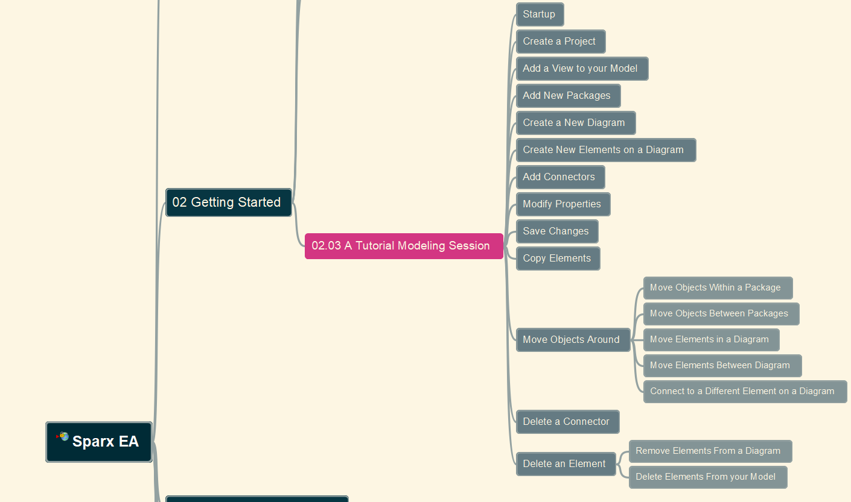
Learning Sparx® Enterprise Architect Tool
008 – A Tutorial Modeling Session
Xiaoqi Zhao
https://github.com/yasenstar/enterprise_architecture/blob/master/Sparx/readme.md

Slide 11
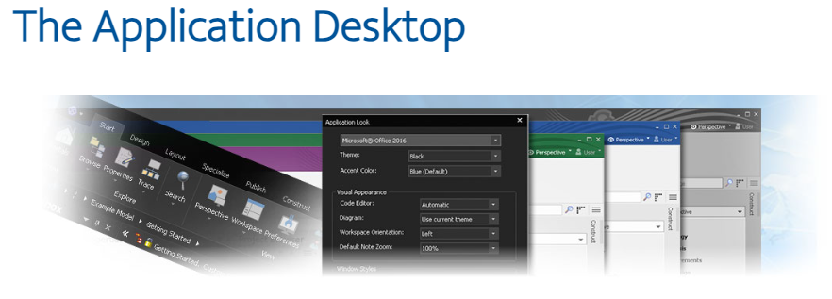
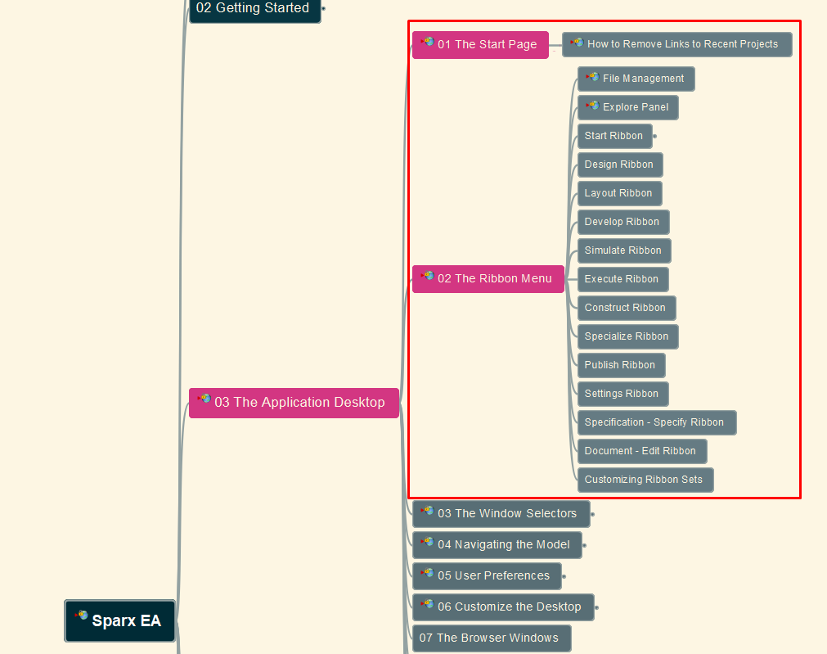
Learning Sparx® Enterprise Architect Tool
009 – Application Desktop – Start Page and Ribbon Menu
Xiaoqi Zhao
https://github.com/yasenstar/enterprise_architecture/blob/master/Sparx/readme.md

